Slide 1
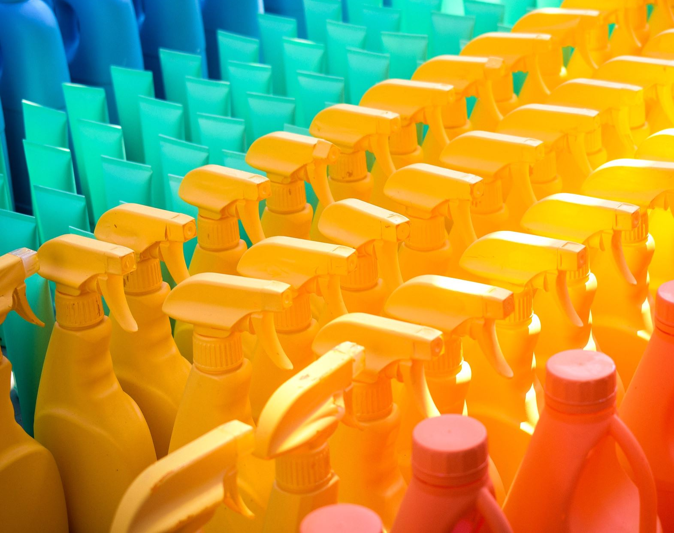
Non-Toxic Cleaning Agents
Chaarshani
Mrinalini M
Praseed Chandriki
Shruthi Nagaraja

Slide 2
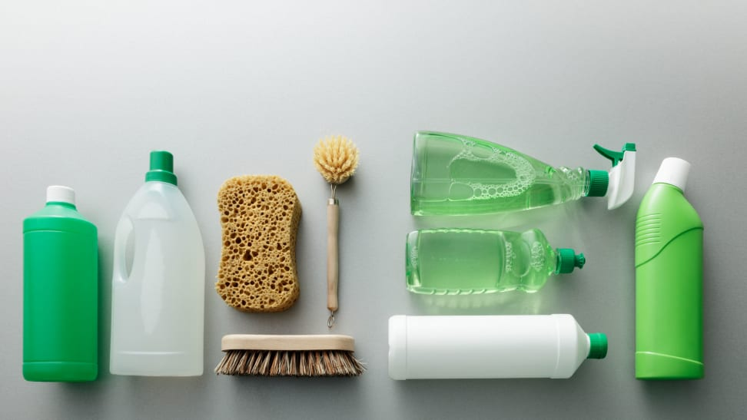
The need for biodegradable and non-toxic cleaning agents to effectively combat dirt and germs and are kind to both consumer and the planet.

Slide 3
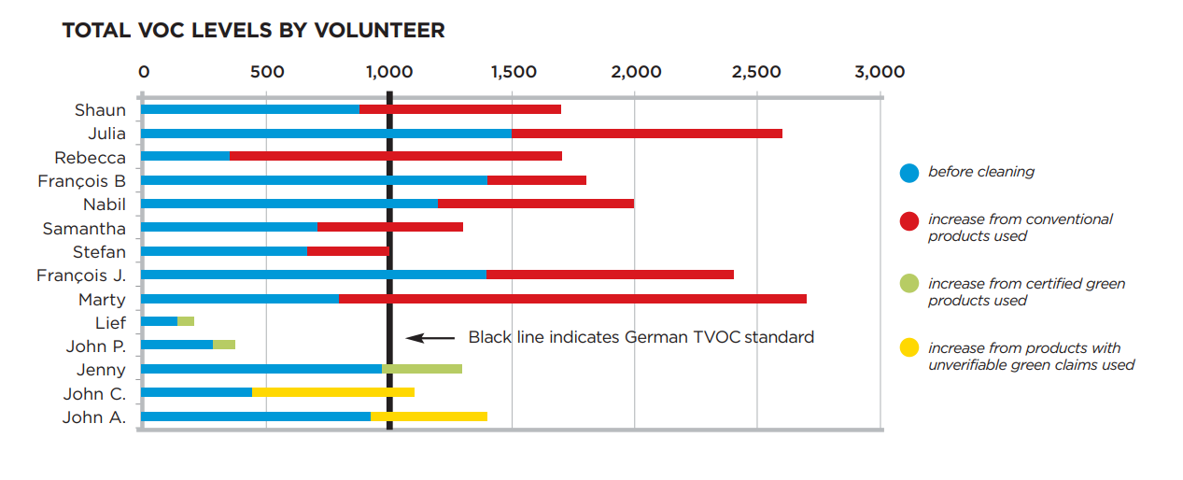
We have developed a habit of using chemical cleaners, often unaware of the significant impacts and harms these products pose.
VOCs, Ammonia, chlorine, phosphates, EDTA, bleach, triclosan and artificial colors
Eutrophication by chemicals
Soil contamination
Air and water Pollution
Infiltration of drinking water
Endocrine disruption
Eye and skin irritation
Not kid or pet friendly

Slide 4
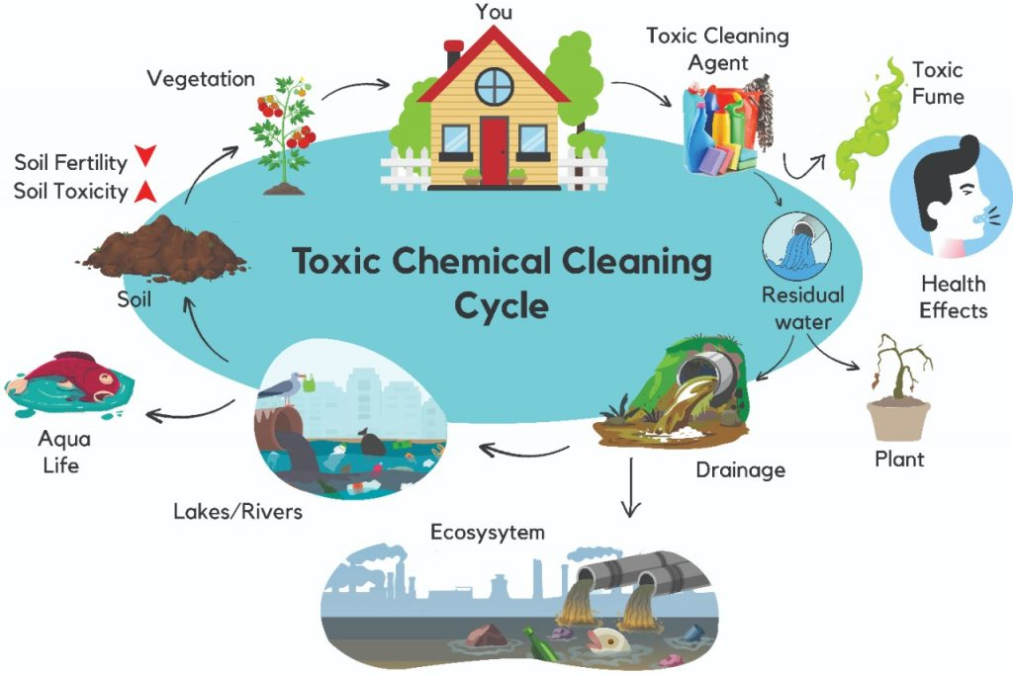
Why Non – Toxic ?

Slide 5
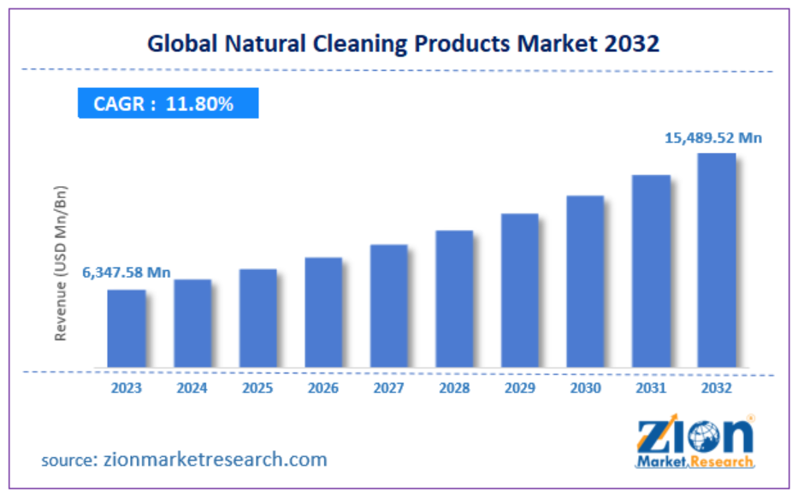
The eco-friendly home hygiene products market in India was valued at $13.98 million in 2023 and is expected to grow at a compound annual growth rate (CAGR) of 33.01%.

Slide 6
What did we do?
Discussed the problem with existing players who are into natural cleaning solution
A consultant helping others to setup Bio enzyme product plant and working on multiple use cases
A couple of Founders who established organic solution in the market
User survey on the product awareness

Slide 7
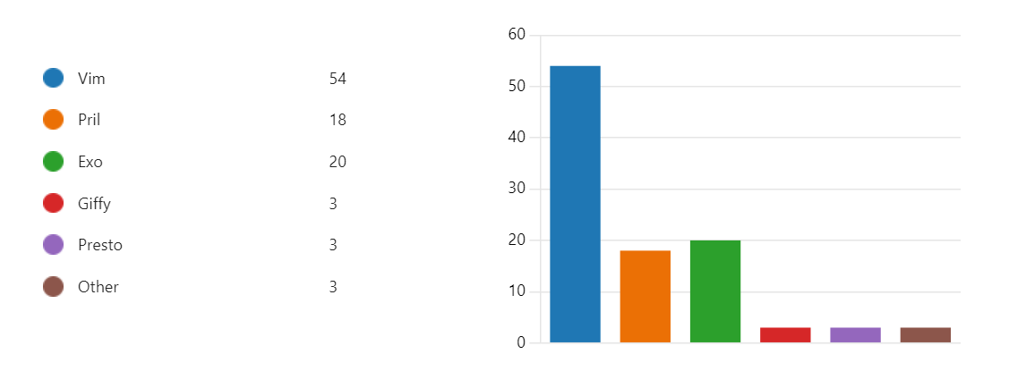
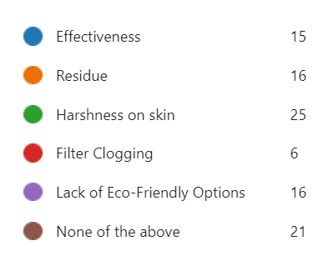
Insights from Consumer Survey
60% of consumers are not aware of Bio enzyme cleaners, 36% heard of it but never tried. (76 consumers)
Current products used:

Slide 8
Insights from Consumer Survey
Brand and price are also major factors, as these products are often viewed as commodities, resulting in less deliberation during purchase.
Harshness on skin, Cleaning Efficiency, Residue are primary concerns during a purchase decision
Most purchase happen through supermarkets, local markets.
People are aware of the problem of using chemicals, but this is not a major concern for them as they haven't found an efficient alternative.

Slide 9
Insights from Industry members
Preciseness while manufacturing
Acceptance of the product due to less foam, froathing
Awareness of the product
Product Shelf life
User Acceptance
Sensitivity in
Manufacturing

Slide 10












TARGET SEGMENT: B2B
Corporates
( Sustainable procurement policy)
Educational institutes
Hospitality industry
Healthcare
Why are natural cleaning agents not widely used in India?
Consumer Habits and preferences
Market Dynamics: Commodity product, price-sensitive
Perception of Efficiency
Lack of Awareness of alternatives

Slide 11
TARGET SEGEMENTS

Slide 12
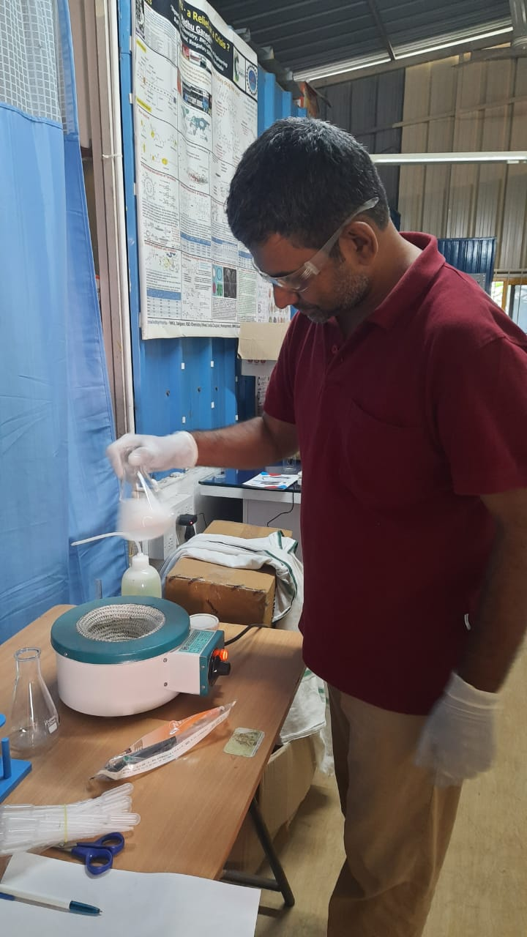
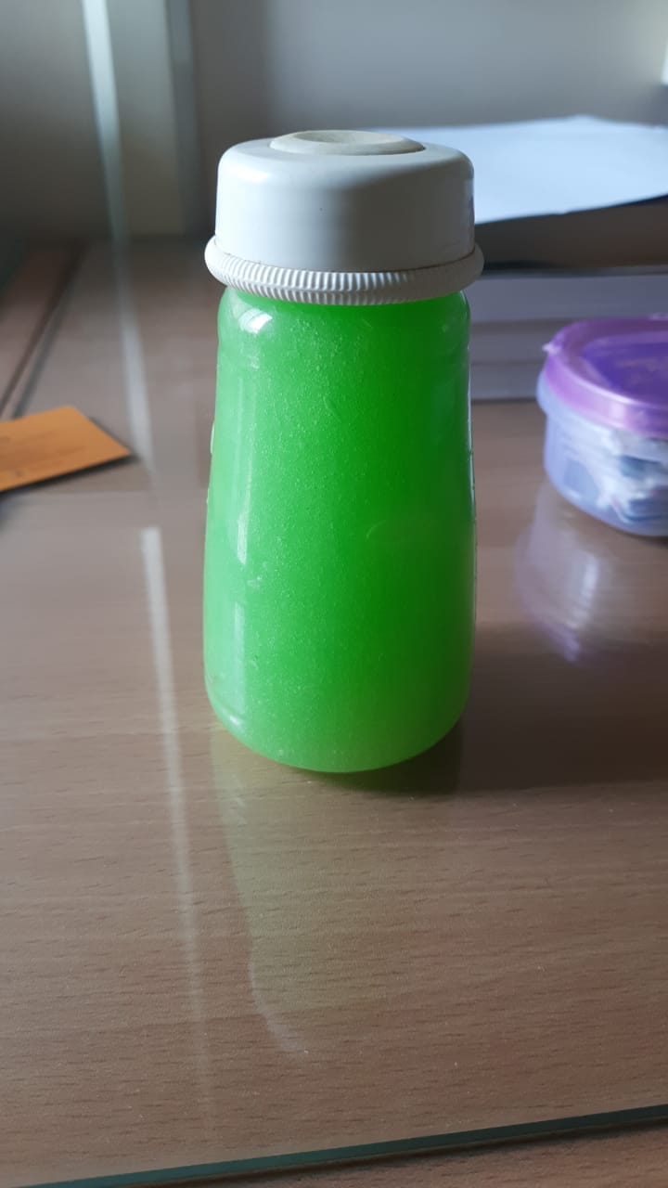
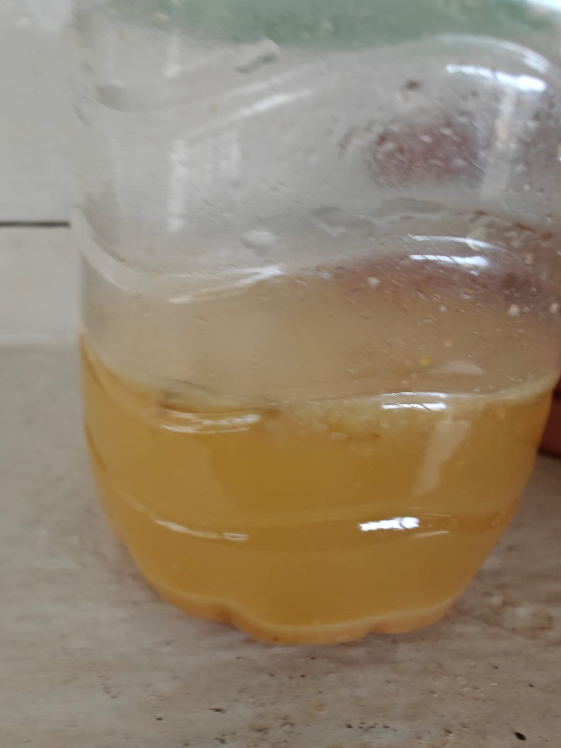
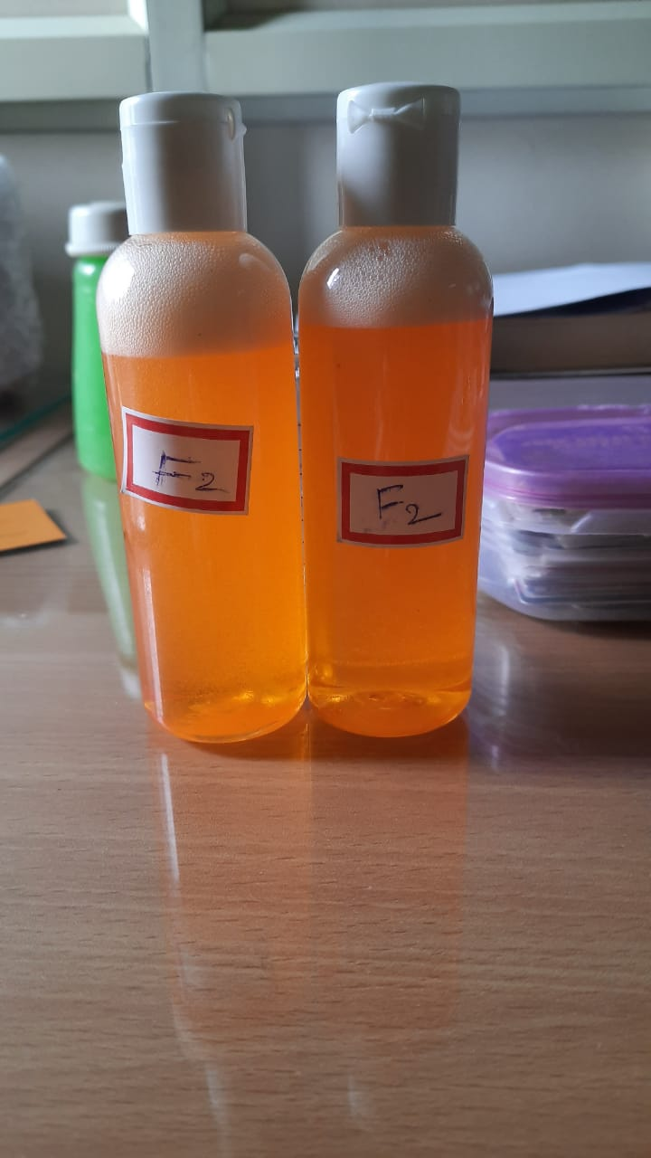
MVP Journey
Developed in collaboration with Vidhathri Institute for Chemical Education, an ISO 9001:2015 firm
We initially started with bioenzyme formulations and subsequently developed an MVP from biosurfactant 1, followed by further enhancements with biosurfactant 2.
Bio Enzyme
Bio Surfactant 1
Bio Surfactant 2

Slide 13
Business Model Canvas
Key activities
Production
R&D
Quality control
Sales
Customer relationship
Community Engagement
Education and training
Sustainability initiatives in corporates
Customer Segments
Industry clients
Eco-conscious consumer
Key Partners
Raw material Suppliers
Technology partners for fermentation and extraction
Value Proposition
Eco-friendly
Effective Performance
Regulatory compliance
Key resources
Manufacturing facilities
Equipment
Scientists, researchers and production staff
Channels
Direct sales
Online
Trade shows
Cost structure
Production costs Operational costs
Distribution costs R&D costs
Revenue
Product sales
Consulting services offering sustainable cleaning practises in companies

Slide 14

Our User Personas

Slide 15

Persona 1: The Health-Conscious Parent
Name: Sara
Age: 32
Occupation: Stay-at-home parent
Location: Suburban area
Challenges: Worried about her children's health, spends a lot of time cleaning, wants to reduce exposure to harmful chemicals.
Goals: Create a safe and healthy home environment, find effective cleaning products that are gentle on skin and surfaces.

Slide 16

Persona 2: The Eco-Warrior
Name: Rithwik
Age: 28
Occupation: Marketing Manager
Location: Urban area
Challenges: Concerned about the environment, wants to reduce plastic waste, finds it difficult to find truly eco-friendly cleaning products.
Goals: Live a sustainable lifestyle, make conscious purchasing decisions, inspire others to be more environmentally conscious.

Slide 17

Persona 3: Sustainability | ESG | CSR Lead
Name: Aparna
Age: 45
Occupation: Sustainability lead
Location: Large corporation
Challenges: Meeting corporate sustainability goals, finding cost-effective cleaning solutions, ensuring compliance with regulations.
Goals: Reduce the company's environmental impact, improve employee satisfaction, save costs on cleaning supplies.

Slide 18
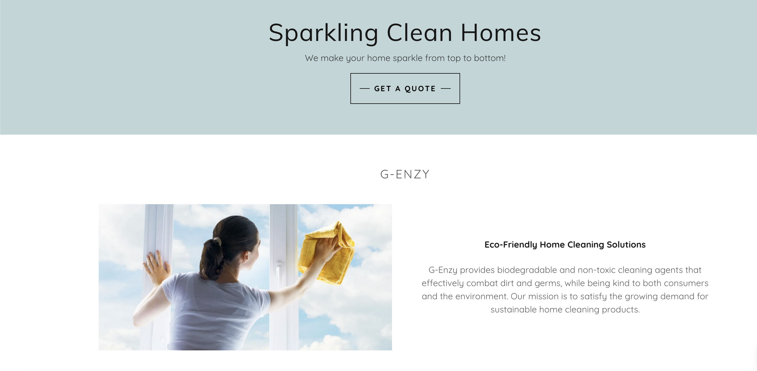


Informational Website Mock-Up
https://g-enzy.godaddysites.com/

Slide 19
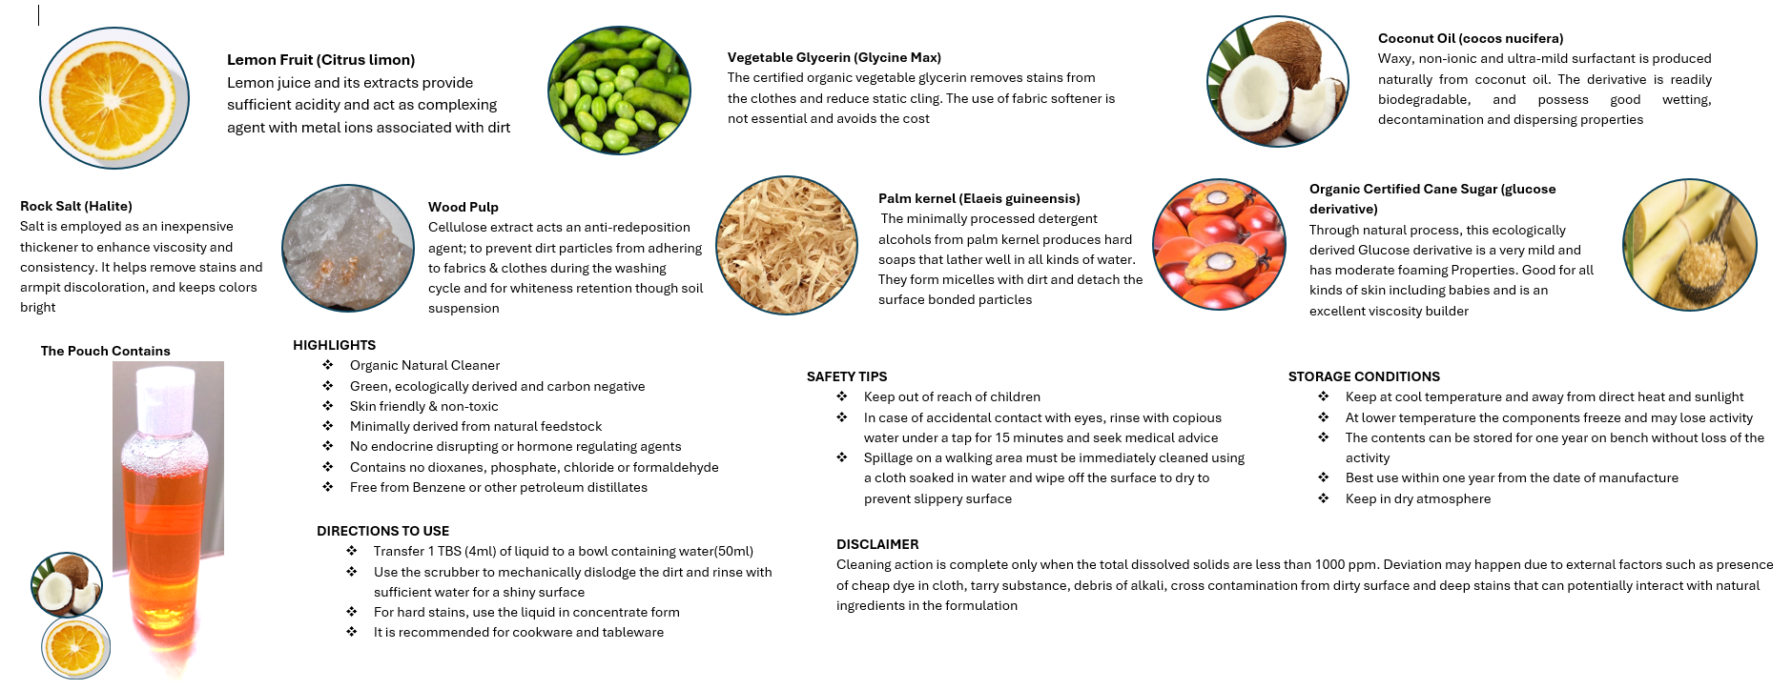
Our Product Brochure

Slide 20
Journey So Far
Natural-based cleaning agents
Address harmfulness of existing chemical cleaners.
Gained Insights on market demand for non-hazardous natural cleaning agents
Understood barriers to stocking bio-enzyme-based products
Identified conditions for stocking natural-based cleaning agents
Developed and tested improved bio enzyme and biosurfactant cleaning agents
Recognized the importance of demos and awareness campaigns.
Identified significant environmental and health risks
Explored sustainable, non-toxic, eco-friendly alternatives
Identified viable segments (corporates, educational institutes, healthcare, hospitality)
Learned from a founder’s successful experience in Europe
Also started exploring on root problem of hard water
Launched a platform for product information and sales
Successfully identified target segments, and prioritized user personas.
Got MVP and brochure ready
Charted out the Business Model Canvas
POSITIVE
Initial Idea
Exploration
Market Research
Strategic Shifts
Product Development
Implementation
Requires ongoing market research and adjustments
Lack of initial expertise and resources
Potential skepticism in the market
Found low awareness and concerns about efficiency residue
Encountered resistance due to fermentation risks and costs
Longer sales cycles and need for relationship building.
Noted the challenges and failures of the B2C model in India.
Iterative process requiring time and resources
High costs and efforts needed for effective marketing
Need to educate consumer about the risks
Faced challenges in stability, cost, skilled labor, potential leaks, and foul smell
CHALLENGES

Slide 21

Our Future Plan
Handing over the samples to min 20 users by next week (Aug 8th)
Collecting product reviews from users
Finalizing the packaging
Designing the sticker to put on the bottles
Continuous product improvisation based on user feedback
Cost Analysis and Pricing Model

Slide 22
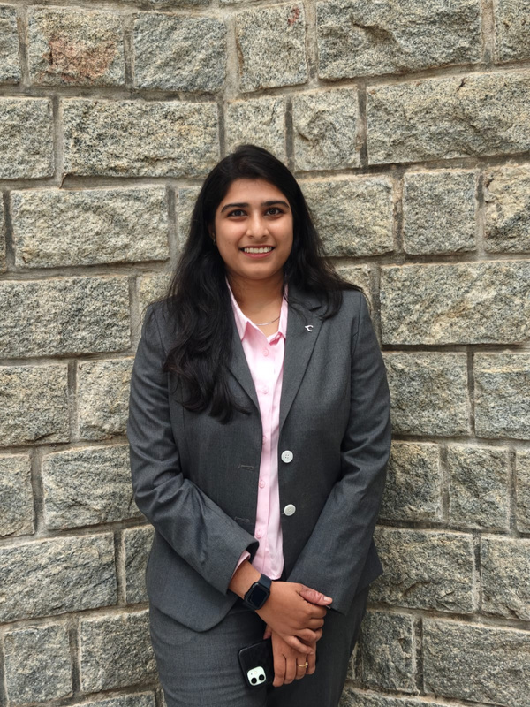
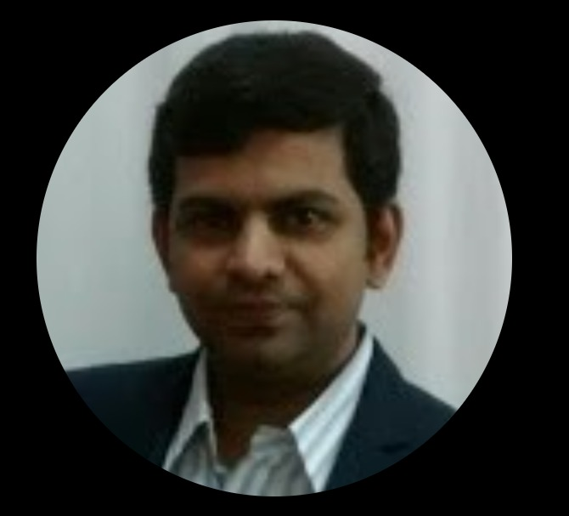
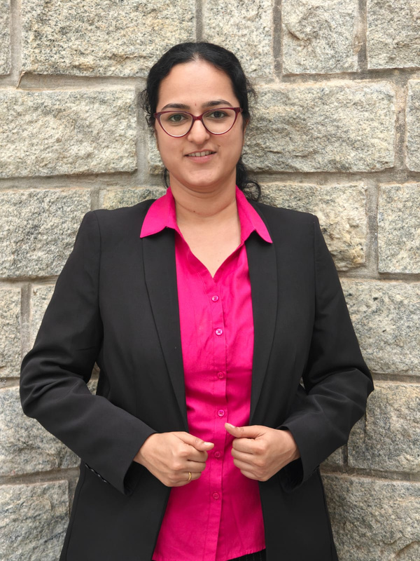
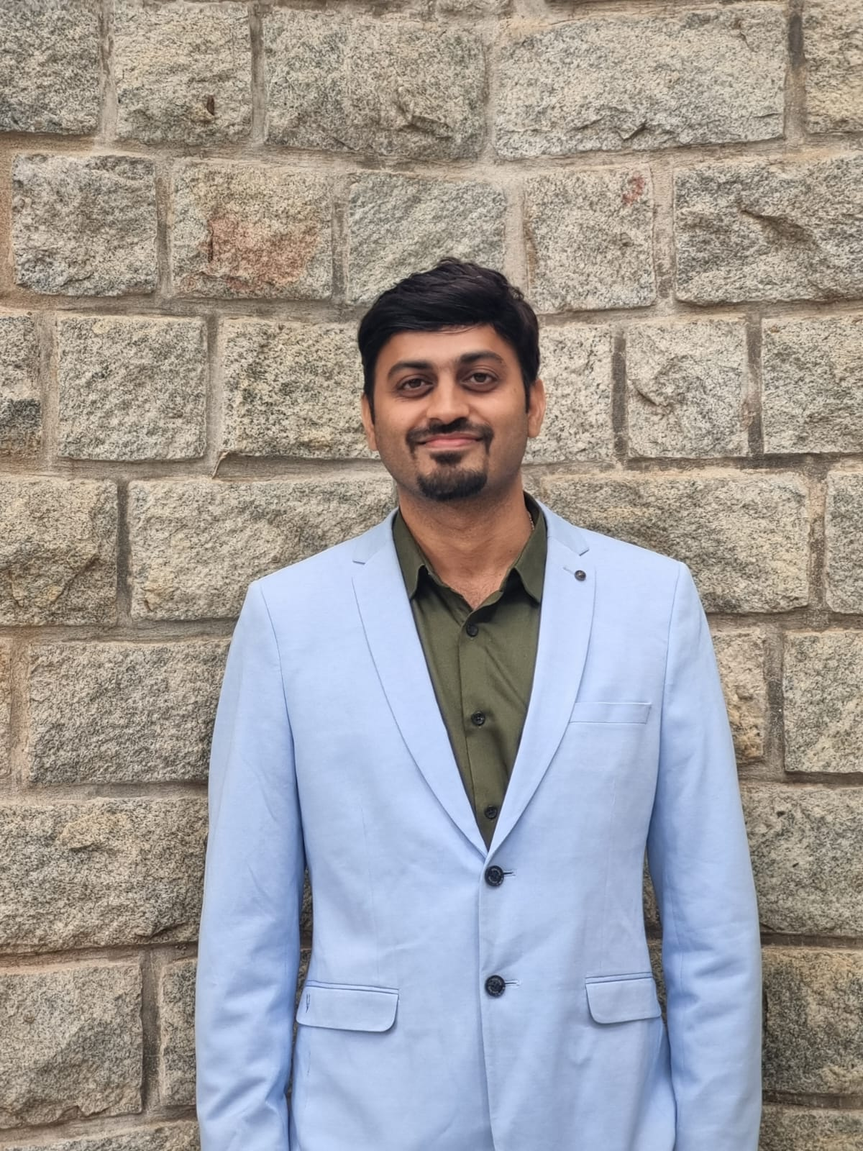
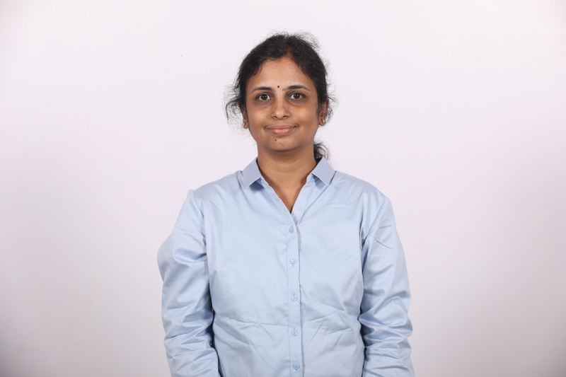
Our Team
Chaarshani D
Dr. Madhu Ganesh
Mrinalini M
Formulation Specialist
Praseed C
Shruthi N
Shruthi

Slide 23
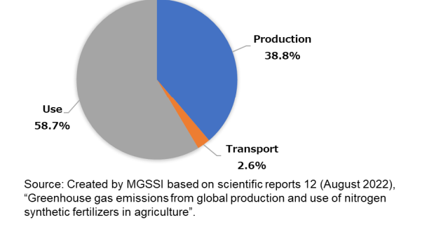

Slide 24
Non-Toxic Cleaning Agents
Chaarshani
Mrinalini M
Praseed Chandriki
Shruthi Nagaraja

Slide 25
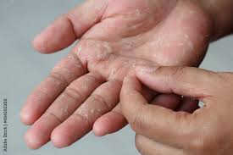

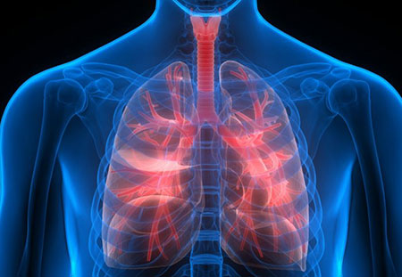
Problem Statement
Pain Points
There’s a need for biodegradable and non-toxic cleaning agents to effectively combat dirt and germs and are kind to both consumer and the planet.
Harsh on Skin
Not pet- friendly and baby-friendly
Volatile organic compounds (VOCs)
cause respiratory issues
Not Good for Water Bodies

Slide 26
Industry insights
Market
CAGR*
Revenue
INR 5000 Crore-6000 Crore
INR 250-600 crore
INR 150-300 crore
Indian home cleaning market
15-20%
24000 Crores
Non-toxic or eco-friendly segment
30-33%
1,500 Crores
Plant based solutions segment
20-25%
450 crores
Growth Drivers Factors
Health Concerns
Increasing Urbanization
Health and Hygiene Awareness
Rise of E-commerce
Increasingly Sustainable Practices
* Estimated for the next 5-7 years as per sources

Slide 27
MVP Journey
Developed in collaboration with Vidhathri Institute for Chemical Education, an ISO 9001:2015 firm
We initially started with bioenzyme formulations and subsequently developed an MVP from biosurfactant 1, followed by further enhancements with biosurfactant 2.
Bio Enzyme
Bio Surfactant 1
Bio Surfactant 2

Slide 28
Unit Economics
Fixed costs | Capacity 100L
Equipment and machinery | 8,00,000
Property | 300000
Electricity | 42000
Saftey equipment | 35000
Waste management | 24000
Labour | 80000
Fixed cost | 12,81,000
Variable cost | 1000ML
Chemicals dervied from plants and natural resources | 212
GST | 37.98
Packaging | 5.2
Label | 2
Variable cost | 257.18
Contribution margin 92.82
Fixed plus variable cost 292.2758904
Selling Price: 350 rupees per litre
Breakeven 13800.90498

Slide 29
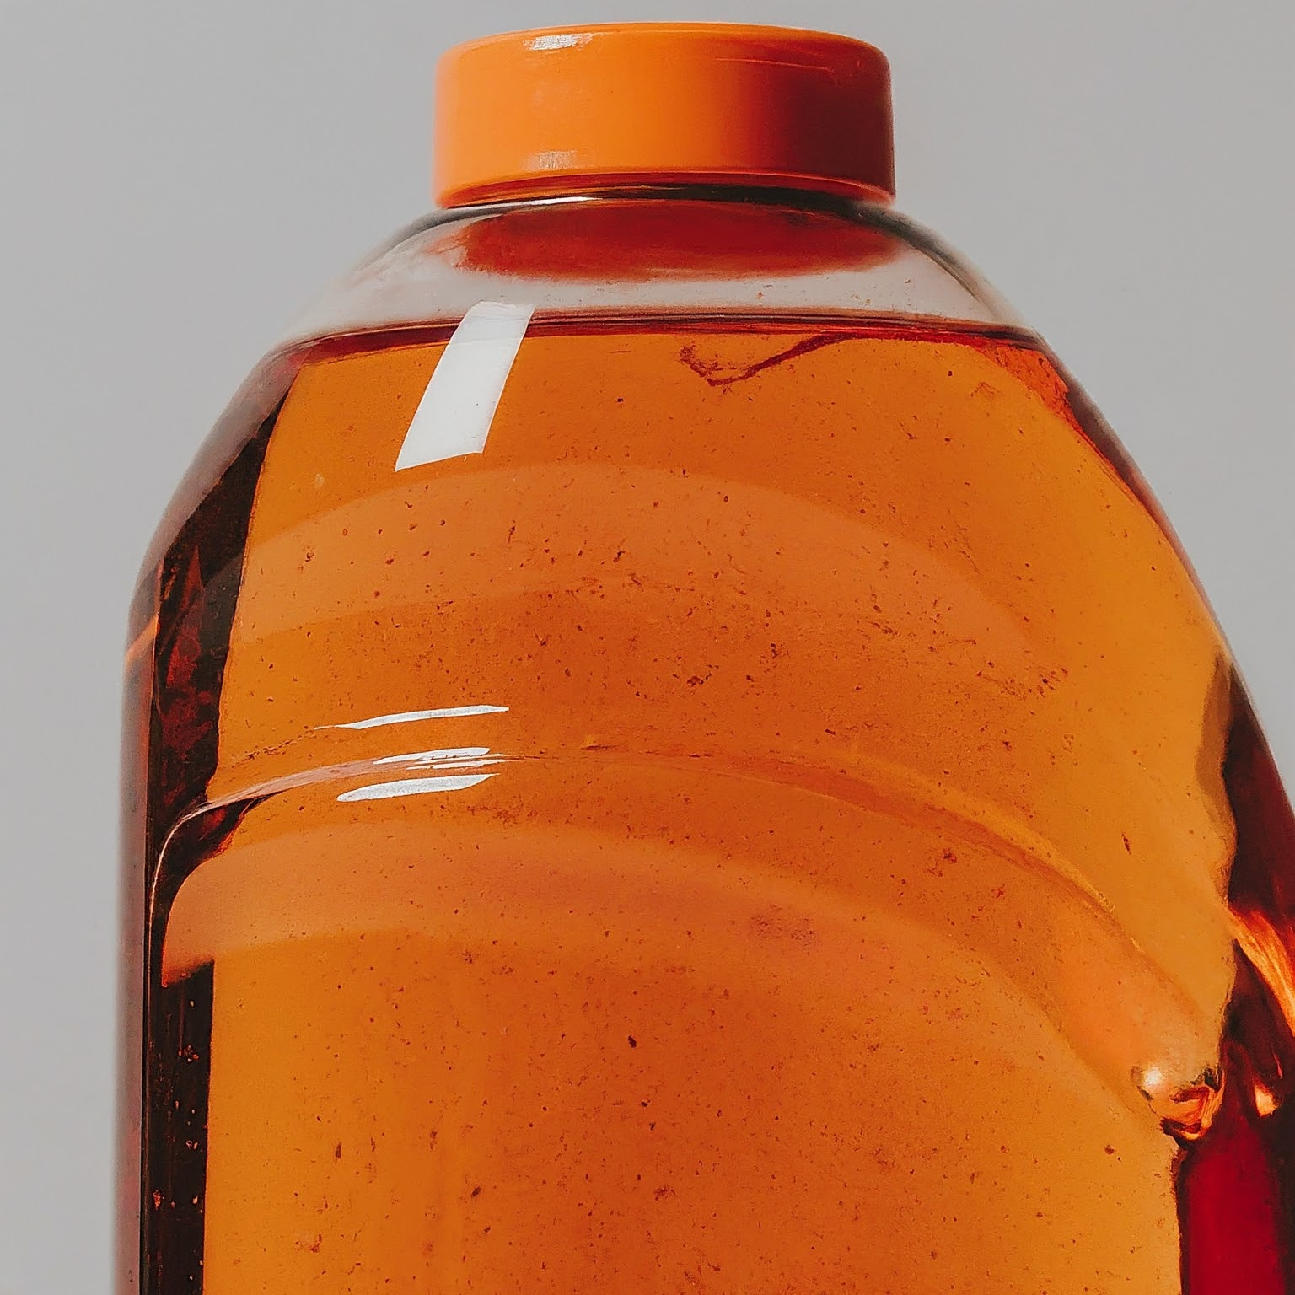
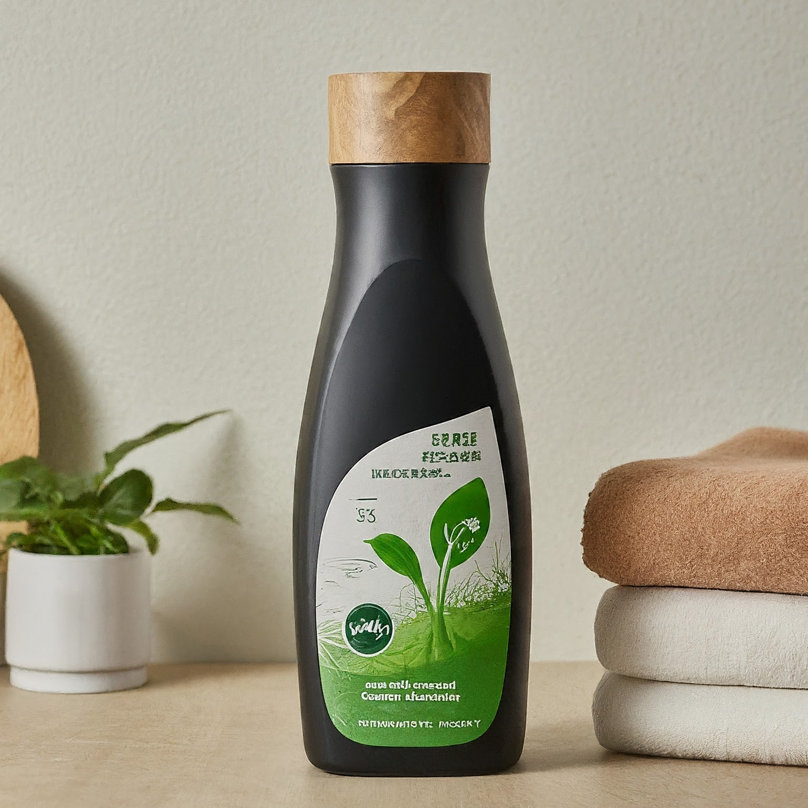
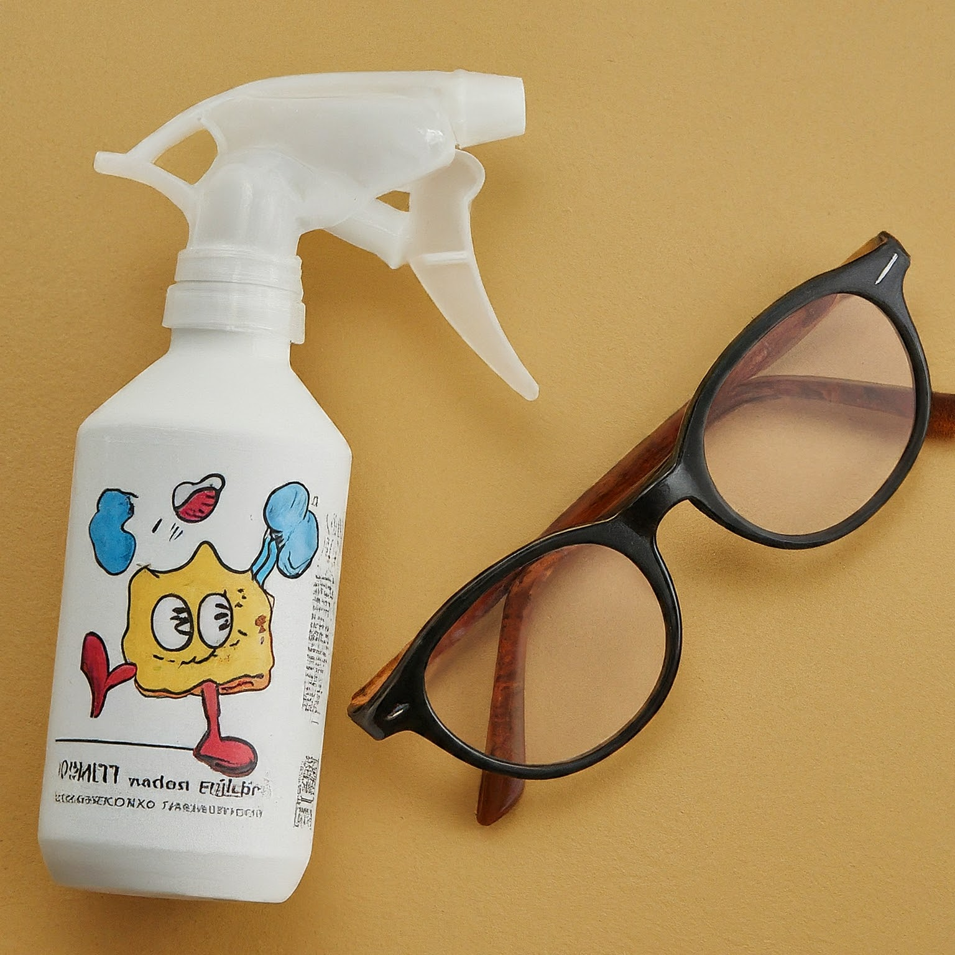
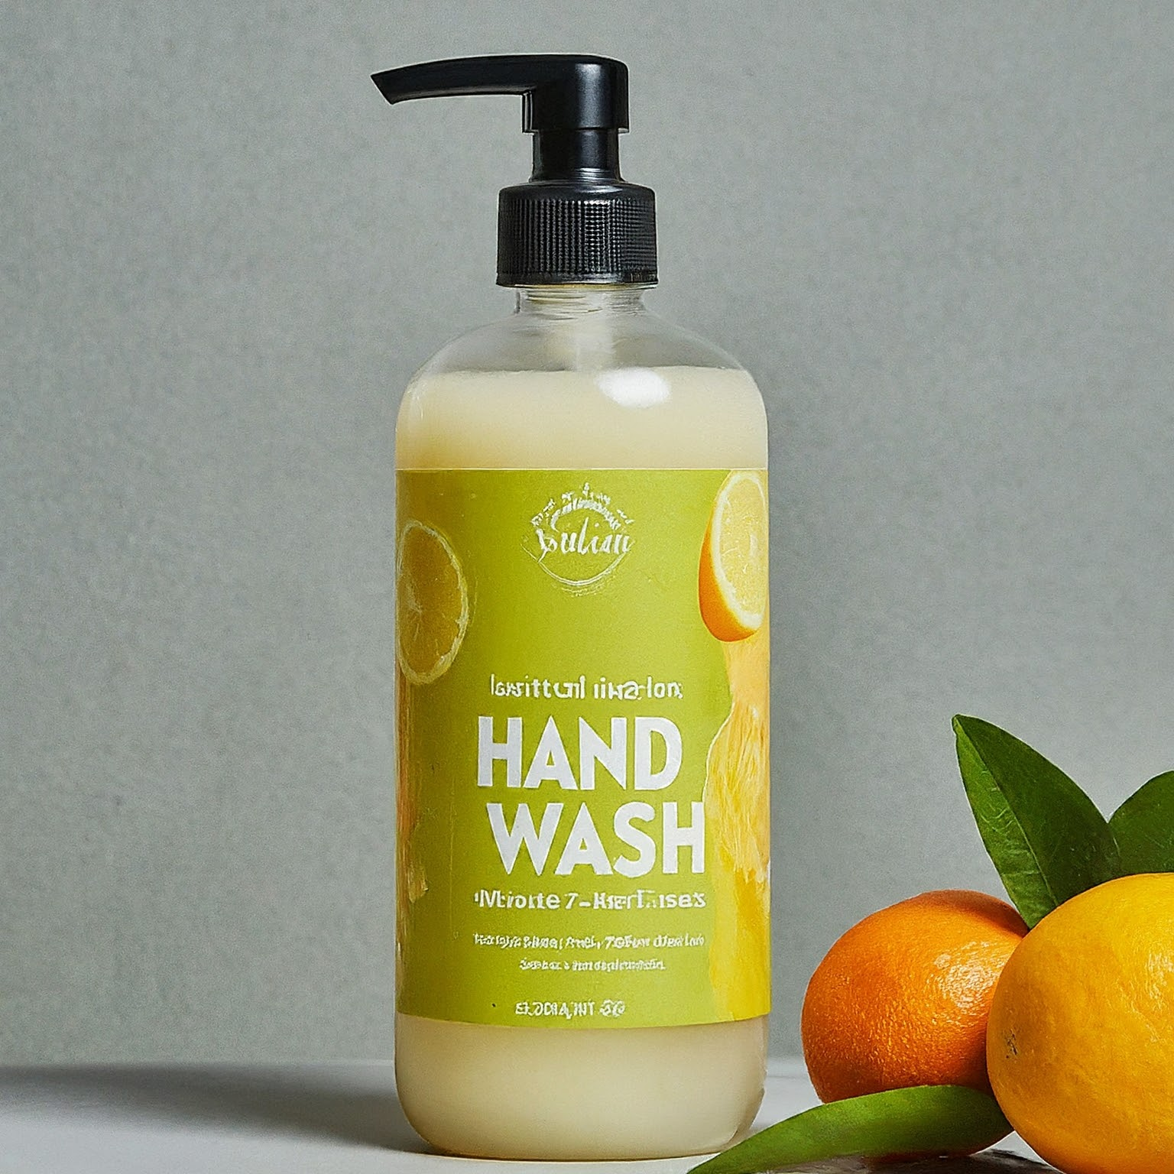
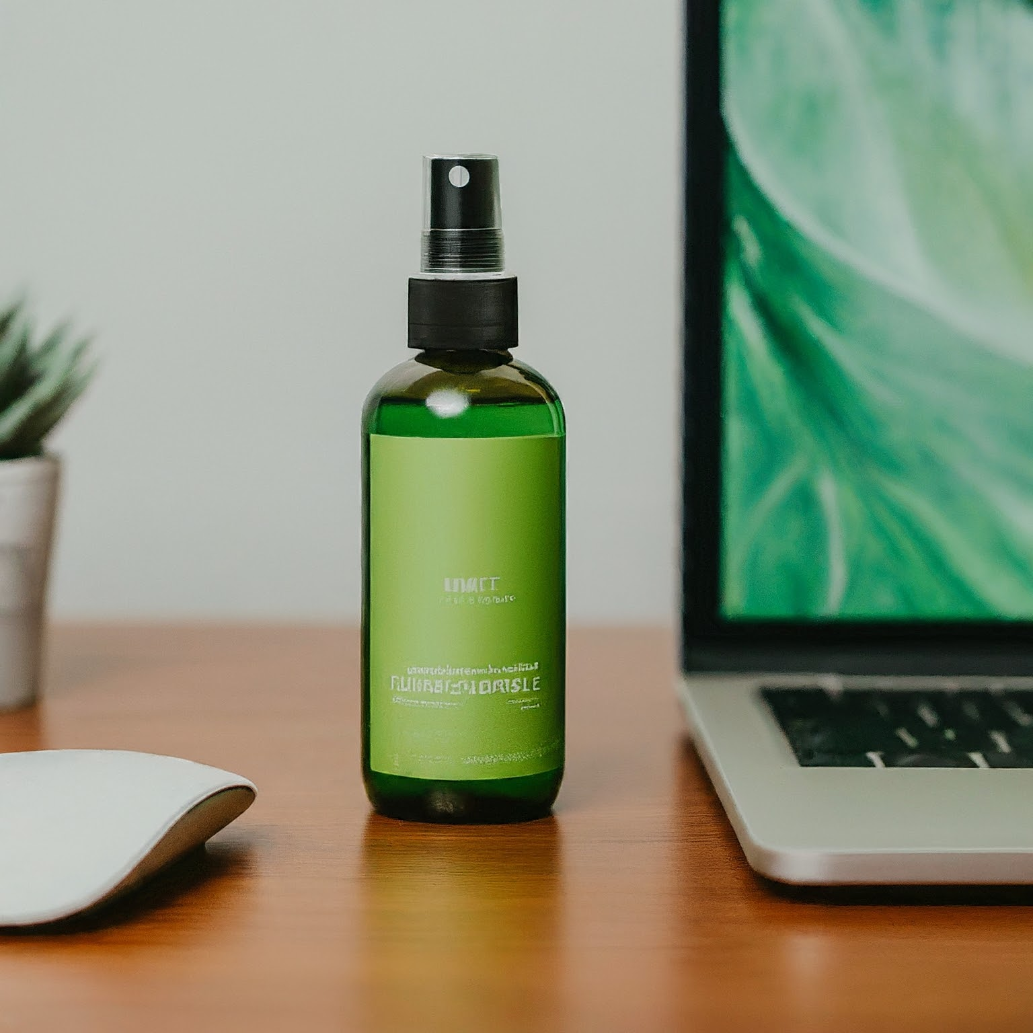
Product portfolio Plan
Dishwashing Liquid
Laundry Detergent
Lens Cleaner
Gadget Cleaning Spray
Hand Wash

Slide 30
Our Target Segments
Eco and Health-Conscious Consumers
Individuals with Allergies and Skin Sensitivity
Organisations with Sustainable Procurement Policies
Pet Owners
Organic and Natural Product Enthusiasts
Parents with young children
Millennial and Gen Z Consumers
Persona 1: The Health-Conscious Parent, who wants to reduce children’s exposure to harmful chemicals
Persona 2: The Eco-Warrior, who’s Concerned about the environment
Our Key Personas 👉🏻
Persona 3: Sustainability | ESG | CSR Lead, who’s trying to meeting corporate sustainability goals

Slide 31
Business Model Canvas
Key activities
Production
R&D
Quality control
Sales
Customer relationship
Community Engagement
Education and training
Sustainability initiatives in corporates
Key Partners
Raw material Suppliers
Technology partners for fermentation and extraction
Key resources
Manufacturing facilities
Equipment
Scientists, researchers and production staff
Customer Segments
Industry clients
Eco-conscious consumer
Value Proposition
Eco-friendly
Effective Performance
Regulatory compliance
Channels
Direct sales
Online
Trade shows
Cost structure
Production costs Operational costs
Distribution costs R&D costs
Revenue
Product sales
Consulting services offering sustainable cleaning practises in companies

Slide 32
Journey so far
Natural-based cleaning agents
Address harmfulness of existing chemical cleaners.
Gained Insights on market demand for non-hazardous natural cleaning agents
Understood barriers to stocking bio-enzyme-based products
Identified conditions for stocking natural-based cleaning agents
Developed and tested improved bio enzyme and biosurfactant cleaning agents
Recognized the importance of demos and awareness campaigns.
Identified significant environmental and health risks
Explored sustainable, non-toxic, eco-friendly alternatives
Identified viable segments (corporates, educational institutes, healthcare, hospitality)
Learned from a founder’s successful experience in Europe
Also started exploring on root problem of hard water
Launched a platform for product information and sales
Successfully identified target segments, and prioritized user personas.
Got MVP and brochure ready
Charted out the Business Model Canvas
POSITIVE
Initial Idea
Exploration
Market Research
Strategic Shifts
Product Development
Implementation
Requires ongoing market research and adjustments
Lack of initial expertise and resources
Potential skepticism in the market
Found low awareness and concerns about efficiency residue
Encountered resistance due to fermentation risks and costs
Longer sales cycles and need for relationship building.
Noted the challenges and failures of the B2C model in India.
Iterative process requiring time and resources
High costs and efforts needed for effective marketing
Need to educate consumer about the risks
Faced challenges in stability, cost, skilled labor, potential leaks, and foul smell
CHALLENGES

Slide 33
Our Future Plan
Handing over the samples to min 20 users by this week (Aug 8th)
Collecting product reviews from users
Finalizing the packaging – done?
Designing the sticker to put on the bottles - done
Continuous product improvisation based on user feedback
Cost Analysis and Pricing Model

Slide 34
Our Team
Chaarshani D
Dr. Madhu Ganesh
Mrinalini M
Formulation Specialist
Praseed C
Shruthi N
Shruthi

